Slide 1
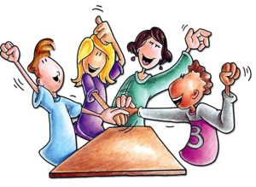
Cooperative Learning: Practical Application
January2019
Presented by: Dr. Brown

Slide 2
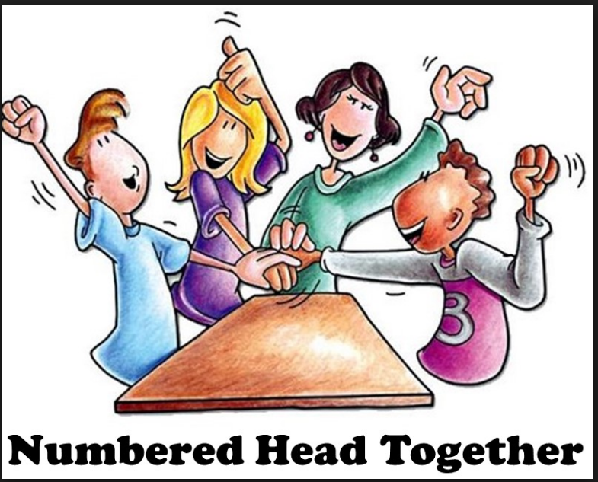
Cooperative Learning
Numbered Heads Together
Numbered Heads Together is a cooperative learning strategy that holds each student accountable for learning the material. Students are placed in groups and each person is given a number (from one to the maximum number in each group). The teacher poses a question and students "put their heads together" to figure out the answer.
This cooperative learning strategy promotes discussion and both individual and group accountability. This strategy is beneficial for reviewing and integrating subject matter. Students with special needs often benefit when this strategy is used.

Slide 3
Fun Facts

Slide 4
Who said “I never ran my train off the track and never lost a passenger”

Slide 5
Answer: Harriet Tubman

Slide 6
Who said “The time is right to do what is right”

Slide 7
Answer: Rev. Dr. Martin Luther King, Jr.

Slide 8
Who said “I don’t want a Black History Month. Black History is American History”

Slide 9
Answer: Morgan Freeman

Slide 10
Who was the first Black American to have their likeness portrayed on a U.S. postage stamp?

Slide 11
Answer: Booker T. Washington

Slide 12

Happy Teaching!

